Slide 1
18CSC205J - OPERATING SYSTEMS
UNIT-1
Session-4,5
SLO 1,2-Understanding the booting process of Linux
SRM Institute of Science and Technology, Ramapuram

Slide 2
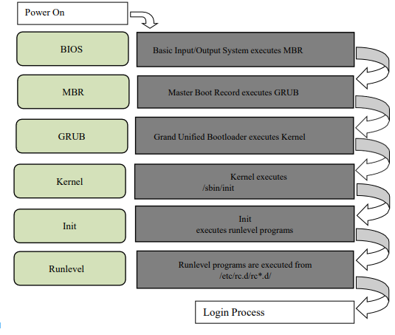
Understanding the booting process of Linux
Objective:
To study various stages of Linux boot process.
SRM Institute of Science and Technology, Ramapuram

Slide 3
Understanding the booting process of Linux
Press the power button on your system, and after few moments you see the Linux login prompt. From the time you press the power button until the Linux login prompt appears, the following sequence occurs.
The following are the 6 high level stages of a typical Linux boot process.
Step 1.BIOS
BIOS stands for Basic Input/ Output System
Performs some system integrity checks
Searches, loads, and executes the boot loader program.
It looks for boot loader in floppy, CD-ROMs, or hard drive. You can press a key (typically F12 or F2, but it depends on your system) during the BIOS startup to change the boot sequence.
Once the boot loader program is detected and loaded into the memory, BIOS gives the control to it.
So, in simple terms BIOS loads and executes the MBR boot loader.
SRM Institute of Science and Technology, Ramapuram

Slide 4
Understanding the booting process of Linux
Step 2. MBR
MBR stands for Master Boot Record.
It islocated in the 1st sector of the bootable disk. Typically /dev/hda, or /dev/sda
MBR is less than 512 bytes in size. This has three components
1) primary boot loader info in 1st 446 bytes
2) partition table info in next 64 bytes
3) mbr validation check in last 2 bytes.
It contains information about GRUB (or LILO in old systems).
So, in simple terms MBR loads and executes the GRUB boot loader.
SRM Institute of Science and Technology, Ramapuram

Slide 5
Understanding the booting process of Linux
Step 3. GRUB
GRUB stands for Grand Unified Bootloader.
If you have multiple kernel images installed on your system, you can choose which one to be executed.
GRUB displays a splash screen, waits for few seconds, if you don‘t enter anything, it loads the default kernel image as specified in the grub configuration file.
GRUB has the knowledge of the filesystem (the older Linux loader LILO didn‘t understand filesystem).
Grub configuration file is /boot/grub/grub.conf (/etc/grub.conf is a link to this).
As you notice from the above info, it contains kernel and initrd image.
So, in simple terms GRUB just loads and executes Kernel and initrd images.
SRM Institute of Science and Technology, Ramapuram

Slide 6
Understanding the booting process of Linux
Step 4. Kernel
Mounts the root file system as specified in the ―root=‖ in grub.conf
Kernel executes the /sbin/init program
Since init was the 1st program to be executed by Linux Kernel, it has the process id (PID) of 1. Do a ‗ps -ef | grep init‘ and check the pid.
initrd stands for Initial RAM Disk.
initrd is used by kernel as temporary root file system until kernel is booted and the real root file system is mounted. It also contains necessary drivers compiled inside, which helps it to access the hard drive partitions, and other hardware.
SRM Institute of Science and Technology, Ramapuram

Slide 7
Understanding the booting process of Linux
Step 5. Init
Looks at the /etc/inittab file to decide the Linux run level.
Following are the available run levels
  0 – halt
  1 – Single user mode
  2 – Multiuser, without NFS
  3 – Full multiuser mode
  4 – unused
  5 – X11
  6 – reboot
Init identifies the default initlevel from /etc/inittab and uses that to load all appropriate program.
Execute ‗grep initdefault /etc/inittab‘ on your system to identify the default run level
If you want to get into trouble, you can set the default run level to 0 or 6. Since you know what 0 and 6 means, probably you might not do that.
Typically you would set the default run level to either 3 or 5.
SRM Institute of Science and Technology, Ramapuram

Slide 8
Understanding the booting process of Linux
Step 6. Runlevel programs
When the Linux system is booting up, you might see various services getting started. For example, it might say ―starting sendmail …. OK‖. Those are the runlevel programs, executed from the run level directory as defined by your run level.
Depending on your default init level setting, the system will execute the programs from one of the following directories.
  Run level
  – /etc/rc.d/rc0.d/
  Run level 1 – /etc/rc.d/rc1.d/
  Run level 2 – /etc/rc.d/rc2.d/
  Run level 3 – /etc/rc.d/rc3.d/
  Run level 4 – /etc/rc.d/rc4.d/
  Run level 5 – /etc/rc.d/rc5.d/
  Run level 6 – /etc/rc.d/rc6.d/
SRM Institute of Science and Technology, Ramapuram

Slide 9
Understanding the booting process of Linux
Please note that there are also symbolic links available for these directory under /etc directly. So, /etc/rc0.d is linked to /etc/rc.d/rc0.d.
Under the /etc/rc.d/rc*.d/ directories, you would see programs that start with S and K.
Programs starts with S are used during startup. S forstartup.
Programs starts with K are used during shutdown. K forkill.
There are numbers right next to S and K in the program names. Those are the sequence number in which the programs should be started or killed.
For example, S12syslog is to start the syslog deamon, which has the sequence number of 12. S80sendmail is to start the sendmail daemon, which has the sequence number of 80. So, syslog program will be started before sendmail.
SRM Institute of Science and Technology, Ramapuram

Slide 10
Understanding the booting process of Linux
Login Process
    Users enter their username and password
    The operating system confirms your name and password.
    A "shell" is created for you based on your entry in the "/etc/passwd" file
    You are "placed" in your "home“ directory.
    Start-up information is read from the file named "/etc/profile". This file is known as the system login file. When every user logs in, they read the information in this file.
    Additional information is read from the file named ".profile" that is located in your "home" directory. This file is known as your personal login file.
    Outcome:
    Learned the various stages of Linux boot process.
SRM Institute of Science and Technology, Ramapuram

